Slide 1
Care Plus Program (CPP)
Multi-Disciplinary Team (MDT)

Slide 3
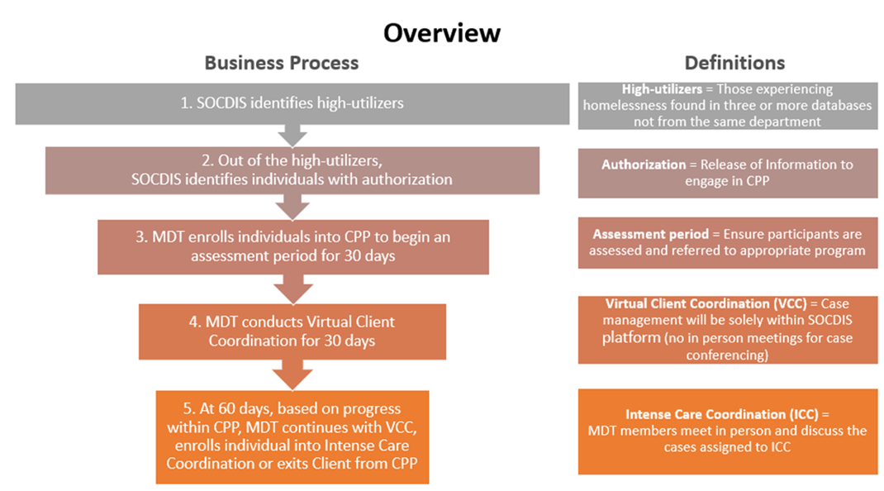

Slide 4
MDT purpose and function
Purpose: Promote connection to services and resources for those experiencing homelessness
  Supports the function of Virtual Care Coordination (VCC)
  VCC occurs for those clients who appear in at least 3 County Systems of Care
  Establish criteria to identify clients from that cohort who then may become eligible for Intense Care Coordination (ICC)
  Responsible for development and implementation of a Care Plan and Care Goals
  OCC facilitates MDT meetings

Slide 5
MDT principles
Collaborate on a unifying philosophy centered on care of the client and the community.
Learn about other County departments / disciplines, respect others’ skills/knowledge and promote positive attitudes.
Shared responsibility for client care and work continuously on overcoming barriers.
Establish a common language and shared documentation that underpins effective care coordination.

Slide 6
MDT member responsibilities
  Expert input from Behavioral Health, Corrections, Healthcare, Housing / Homelessness, Benefits and Support services
  Ensure consistency of representation for each client connected with, or potentially in need of their services
  Collaborate with lead facilitator and MDT members to meet and expedite care coordination timeframes
  Share and communicate relevant MDT information and actions within their County department in line with AB210 MOU and SOCDIS Privacy and Security guidelines.
  Support and inform the development of the Care Plan and contribute measurable goals for the purpose of addressing and preventing homelessness
Notes:
Behavioral health: identified mental health and psychological factors, including recommendations and access to assessment, diagnosis and treatment.
Corrections: the safety and security of the client and community, probation requirements and compliance with any orders.
Healthcare: physical health, inpatient and outpatient care, diagnosis and treatment options and compliance.
Housing/Homelessness: progress and engagement with housing navigation, case management interventions and access to a range of housing options, including shelter, transitional and permanent supportive housing.
Benefits and support services: eligibility for, access and benefit assistance programs that promote stability and self-sufficiency.

Slide 7
Intense Care Coordination (ICC) criteria for discussion:
DRAFT
Healthcare
Admitted to hospital 3 times in last 90 days
Corrections
Went to jail 4 times in the last year
Homelessness
Length of homelessness
Length of shelter stay
Chronic homelessness
Frequent, short incarcerations
Mental health related incarcerations
Repeated and frequent visits to emergency departments
Behavioral Health
Homeless Liaison Officer Contacts
Benefits and Support Services
Three interactions with homeless liaison officers in last 30 days
No active SSI / SSDI claim
Chronic or untreated co-occuring psychiatric and substance use disorders
Repeated and frequent visits to psychiatric crisis centers
Multiple mental health related arrests

Slide 8
MDT member considerations
Use of real time case information - workflow process for feeding back decisions or actions, and delegation and monitoring of those actions
The VCR will only be as up to date as the information held within each County System of Care – shared timescale expectations for updating and completion of case records?
How any existing client centered documentation interacts / interfaces with the development of an MDT Care Plan

Slide 9
Questions?

